Slide 1
An Impossible Escape
HackerTalks, Delta Force

Slide 2
Warm Up
A King somewhere far, far away is throwing a party
1 of the 1000 bottles of wine to be served is poisoned

Slide 3
Warm Up (cont.)
He has exactly 10 prisoners on death row at his disposal to test the wine
The poison takes 24 hours to act on the body

Slide 4
Warm Up (cont.)
However, the party starts in exactly 24 hours.

Slide 5
How would you get the prisoners drunk to find the poisoned bottle of wine?
Assume the wine bottles are labeled 1 to 1000.
Notes:
Add cartoon

Slide 6

Think in binary.
Notes:
Add drunk ppl image

Slide 7

#1 0 0 0 0 0 0 0 0 0 1
#36 0 0 0 0 1 0 0 1 0 0
#420 0 1 1 0 1 0 0 1 0 0
1
Notes:
Add drunk ppl image

Slide 8
The Impossible Escape - The Problem
Your friend and you are imprisoned
One chance to escape
The jailer calls you in, has an 8x8 chessboard with him
There is one coin in a random state (H/T) on each square
The jailer picks one square on the board
Notes:
Add cartoon

Slide 9
You see this and are allowed to flip exactly one coin on the board
You leave the room and your friend walks in (no communication between you)
Your friend needs to identify the jailer’s square by only looking at the board
You can discuss a strategy with your friend before the jailer calls you in
The Impossible Escape - The Problem (cont.)
Notes:
Distribute papers

Slide 10

Notes:
Add drunk ppl image

Slide 11
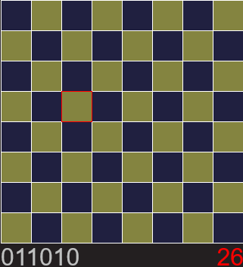
The jailer’s square can be represented by a six digit binary number.
Notes:
Add drunk ppl image

Slide 12
Can you encode a six-digit binary number in the board for your friend to see?
Notes:
Add drunk ppl image

Slide 13
Parity!
Notes:
Add drunk ppl image

Slide 14
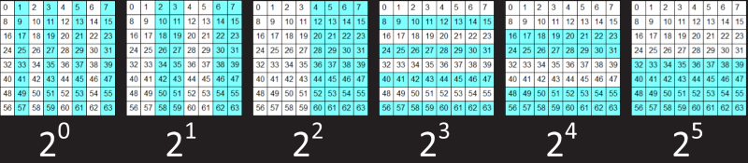
Notes:
Add drunk ppl image

Slide 15
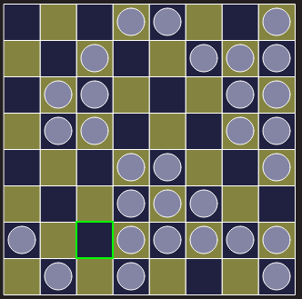
Parity (2^0) =
Parity (2^1) =
Parity (2^2) =
Parity (2^3) =
Parity (2^4) =
Parity (2^5) =
The board has a natural parity that comes from the jailer’s arrangement of coins on it - count the number of heads in each segment
0
1
0
0
1
1
Board Parity: 110010
Notes:
Add drunk ppl image

Slide 16
We now have a six-bit number encoded in the board…
How do we change it (the board’s parity) to the jailer’s number by flipping one coin?
Notes:
Add drunk ppl image

Slide 17
The jailer’s number : 0 1 1 0 1 0
The board’s parity : 1 1 0 0 1 0
-> The 5th and 3rd bits of the board’s parity are different from the jailer’s number
-> So, on flipping one coin, the parity of the 5th and 3rd segments of the board should change
Notes:
Add drunk ppl image

Slide 18
-> The coin to be flipped belongs to only the 5th and 3rd segments of the board
-> This coin is 101000 (40)
-> So when you flip coin #40, the parity of the board will be equal to the jailer’s square
-> This is exactly the definition of the XOR operation - XOR a bit with 1 if you want it to change and with 0 if you don’t
-> So the coin to be flipped is nothing but (jailer’s number) XOR (Board’s parity).
Notes:
Add drunk ppl image

Slide 19
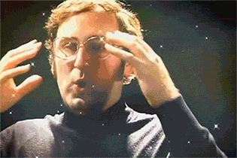
Yay!
Bits can save your life.
Notes:
Add drunk ppl image

Slide 20
Some bit twiddling hacks
-> To compute the sign of an int, you can do int sign = n >> (sizeof(int) * 8 – 1) -> This is faster than if (n < 0) as there is no branch/jump instruction involved
Notes:
Add drunk ppl image

Slide 21
Some bit twiddling hacks
To check if 2 ints have opposite signs bool a = ( (x ^ y) < 0 )
Notes:
Add drunk ppl image

Slide 22
Some bit twiddling hacks
To check if an int is a power of 2 bool a = ( (x & x-1) == 0 )
Notes:
Add drunk ppl image

Slide 23
Take this problem home!
To compute min(x,y) int min = y ^ ((x ^ y) & -(x < y))
Notes:
Add drunk ppl image

Slide 24

Notes:
Add drunk ppl image

